Slide 1
MOBILE SIGNAL STRENGTH PREDICTOR

Slide 2
INTRODUCTION
  Mobile networks are the backbone of modern communication.
  However, signal strength varies due to location, obstacles, tower distance, and frequency bands.
  A Mobile Network Signal Strength Predictor helps estimate coverage quality using Machine Learning.
  It assists users (to choose better locations/networks) and telecom companies (to optimize tower placement).

Slide 3

PROBLEM STATEMENTS AND OBJECTIVES:
Problem
•Uneven and weak mobile network coverage in many regions.
• Frequent call drops, slow internet, and poor connectivity.
Objectives
• Predict signal strength using ML models.
• Preprocess & analyze real signal datasets.
•Improve prediction accuracy with feature engineering.
• Provide insights for better connectivity planning.

Slide 4
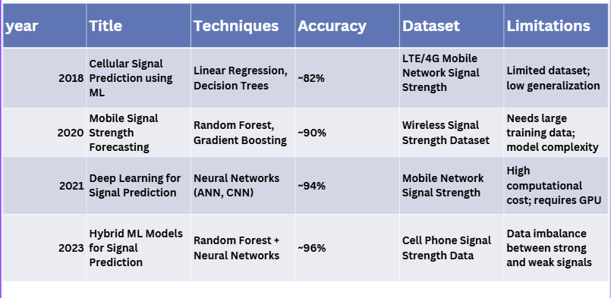
LITERATURE SURVEY TABLE:

Slide 5
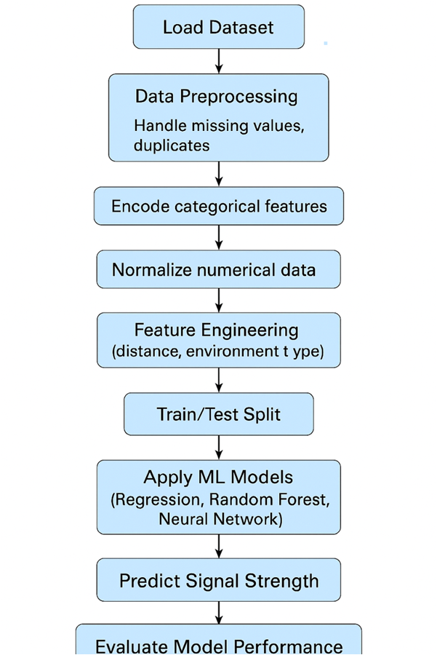
FLOWCHART:

Slide 6
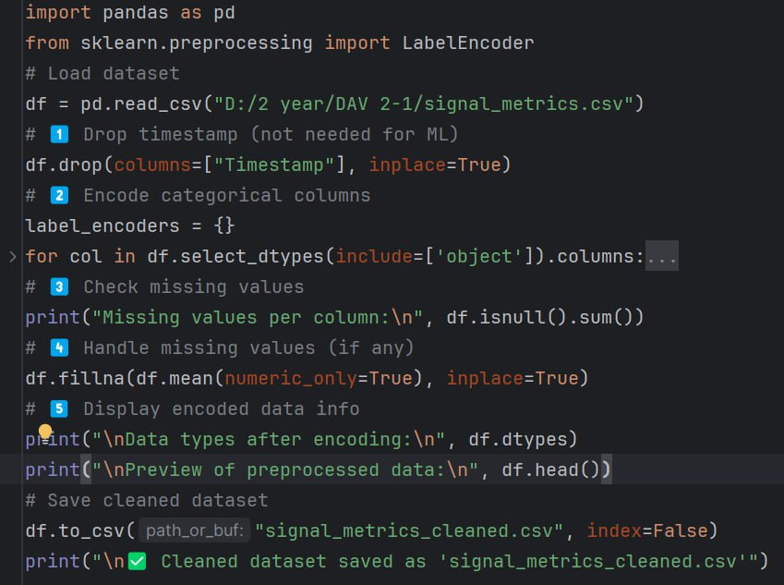
PreProcessing

Slide 7
PREPROCESSING DATA:
  Removed column:
Timestamp → dropped because it’s a time string, not useful for model training or categorical visualization.
  Encoded categorical columns:
Locality and Network Type were converted from text (object) → numeric codes using LabelEncoder.
  Example:
Network Type: 3G → 0, 4G → 1, 5G → 2, LTE → 3
Locality: each location assigned a unique number.
Checked and handled missing values:
Replaced any missing numeric values with the mean of that column.
Kept all numeric columns unchanged:
Columns like Signal Strength (dBm), Signal Quality (%), Latency (ms), etc., were kept as-is (only cleaned).

Slide 8
DATASET ANAYLSIS:
  Total records: 16,829
  Total columns: 12 (after preprocessing → 11)
  Data type mix:
  9 numeric columns
  3 categorical columns (Timestamp, Locality, Network Type)

Slide 9
FEATURE SELECTION:
  Used a Correlation Heatmap to find which features influence Signal Strength.
  Identified that Throughput, Latency, Latitude, and Longitude have the strongest relationships with the target.
  These four were selected as the final input features (X).
  Signal Strength (dBm) was chosen as the target (Y).

Slide 10
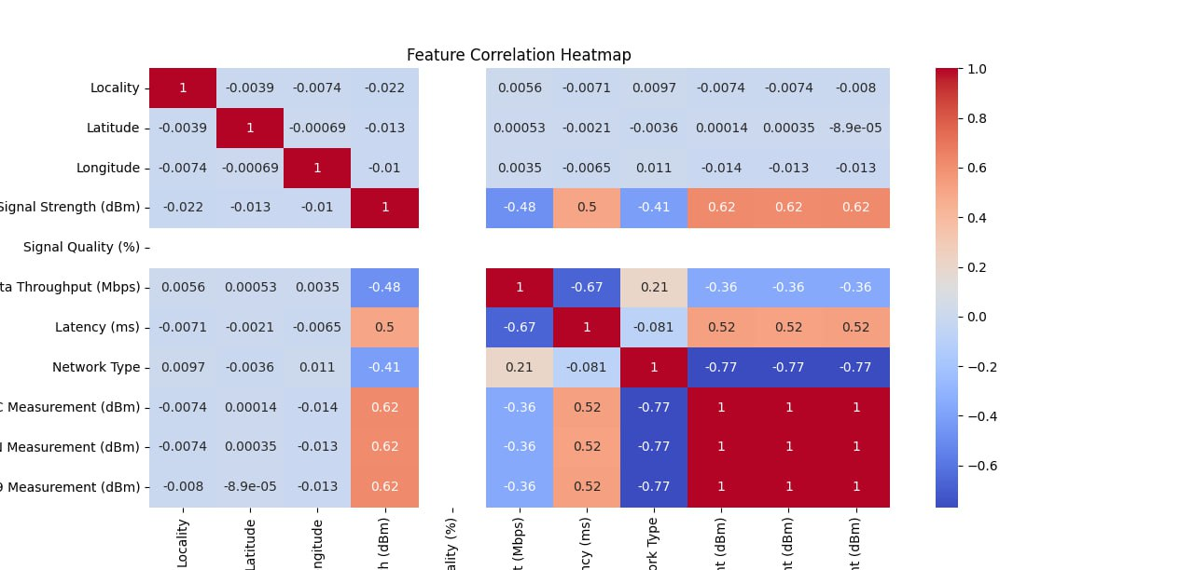
visualization:
Heat Map
Dark Red
High signal → high speed
Low signal → low speed
Dark Blue
High signal → low latency (good)
Low signal → high latency (bad)
Latitude & Longitude have very low correlation with Signal Strength
Network Type has a noticeable impact on signal strength.
Data Throughput (Mbps) is strongly related to measured signal values.
Latency has opposite behavior — strong signal reduces latency.

Slide 11
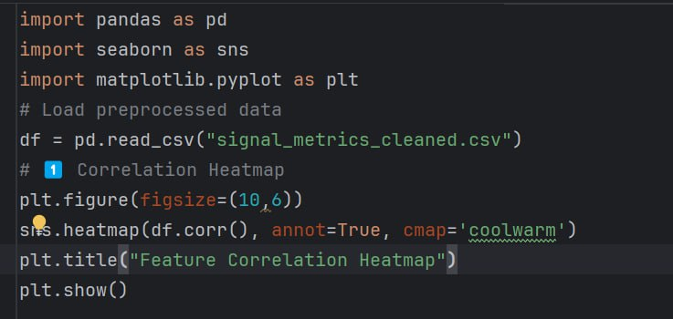

Slide 12
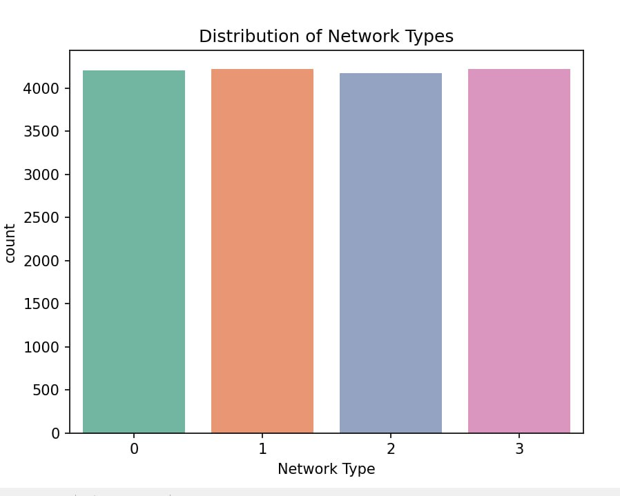
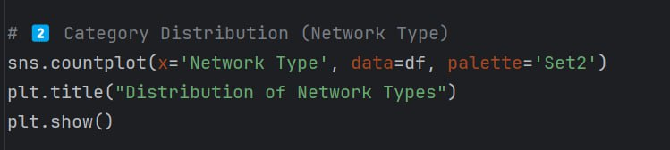
Categorical Distrubution
X-axis = Network Type, Y-axis = Count.
All bars are nearly equal → dataset is balanced across network types.

Slide 13
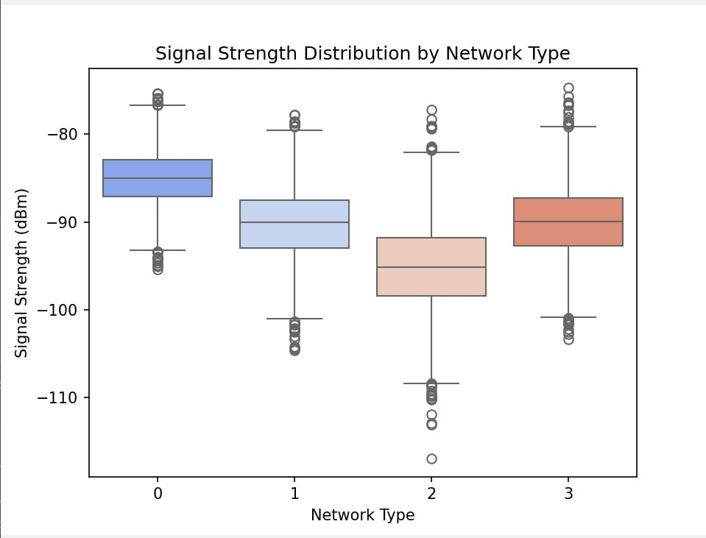
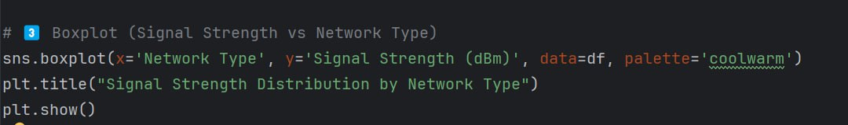
Box Plot
X-axis = Network Type, Y-axis = Signal Strength (dBm).
Median signal varies by network type — higher networks generally have stronger (less negative) signals.
Outliers show extreme weak or strong signals.

Slide 14
THANKYOU

